Slide 1
Group 23
PC Logger - Tool for System Monitoring and Reporting
Presented by:-
Vaibhav Gangurde
Dhiraj Kapse
Mahek Mulla

Slide 2
Introduction
Problem Statement
Literature Survey
Limitation and Overcome
Project Proposal
Block Diagram
Outputs
Conclusion
Contents

Slide 3
Indroduction
PC Logger is a Python-based tool for monitoring and reporting on PC systems.
It collects information about a PC's hardware and software components and sends it to a Django server. The data is stored in a database and displayed to users using a Django app.
With its search feature and dashboard, PC Logger is an efficient solution for IT professionals and system administrators.

Slide 4
Problem Statement
As the complexity and number of applications running on a system increases, it becomes challenging to monitor and manage system resources effectively.
Traditional methods of system monitoring are inadequate for identifying performance issues and potential security threats.
A need exists for a tool that can log and report on system activity in real-time, providing detailed insights into system performance and user activity. This is where PC Logger comes in.

Slide 5
Literature Review
Previous research has highlighted the need for efficient system monitoring and reporting tools.
Various tools have been developed to aid in this process, However, many of these tools require a significant amount of setup and configuration, making them unsuitable for small to medium-sized businesses.
The PC Logger project provides a cost-effective solution to this problem, using Python and Django.
The project's use of standard Python libraries ensures accurate and efficient collection of system information.

Slide 6
Limitations
Limited Scalability: The PC Logger tool is primarily designed for small to medium-sized businesses, and may not be suitable for large-scale enterprise systems.
Limited functionality: No advanced features like real-time monitoring, alerting or remote access.
Reliance on network stability: Requires a stable network connection to communicate between PC clients and Django server.

Slide 7
Overcome:
To overcome the limitation of limited scalability and of the PC Logger tool, businesses can consider alternative tools, implement a distributed monitoring architecture, optimize system performance, and upgrade hardware and software.
These strategies can help ensure that the tool is effective in monitoring and reporting on system performance for large-scale enterprise systems or across different operating systems or hardware configurations.

Slide 8
Project Proposal
The purpose of this project proposal is to implement the PC Logger tool for system monitoring and reporting in an organization.
The PC Logger tool is designed to help businesses monitor and report on the performance of their systems, providing real-time insights and alerts to help ensure optimal performance and minimize downtime.

Slide 9
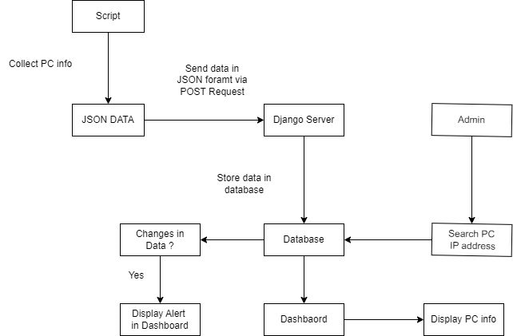
Block Diagram

Slide 10
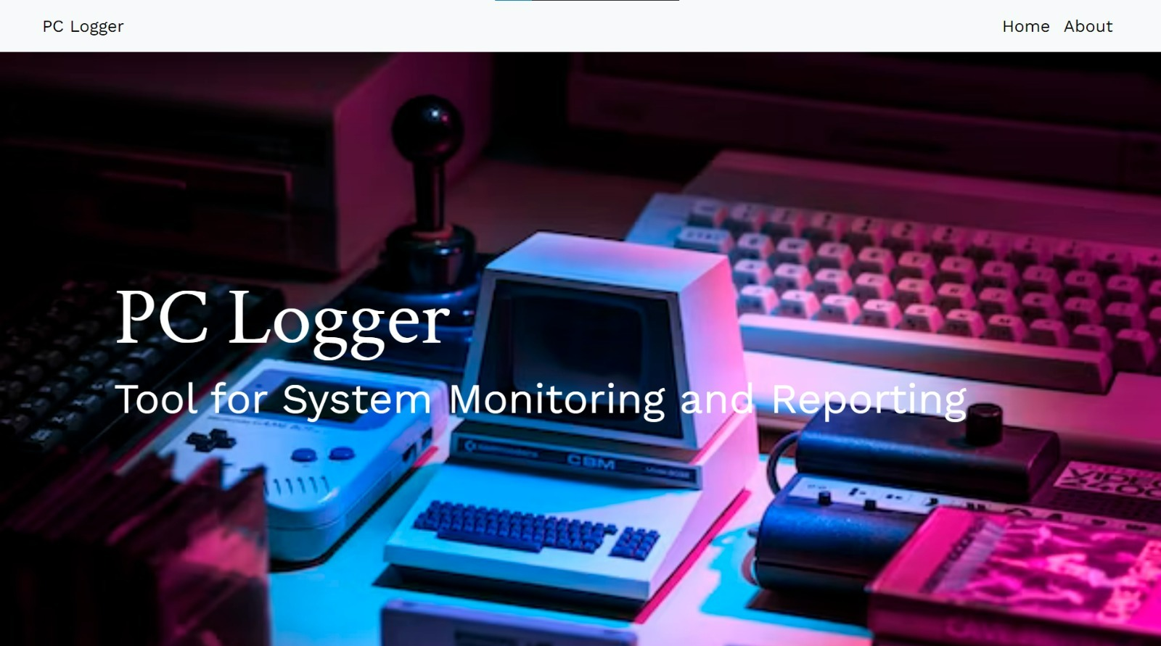
Output:

Slide 11
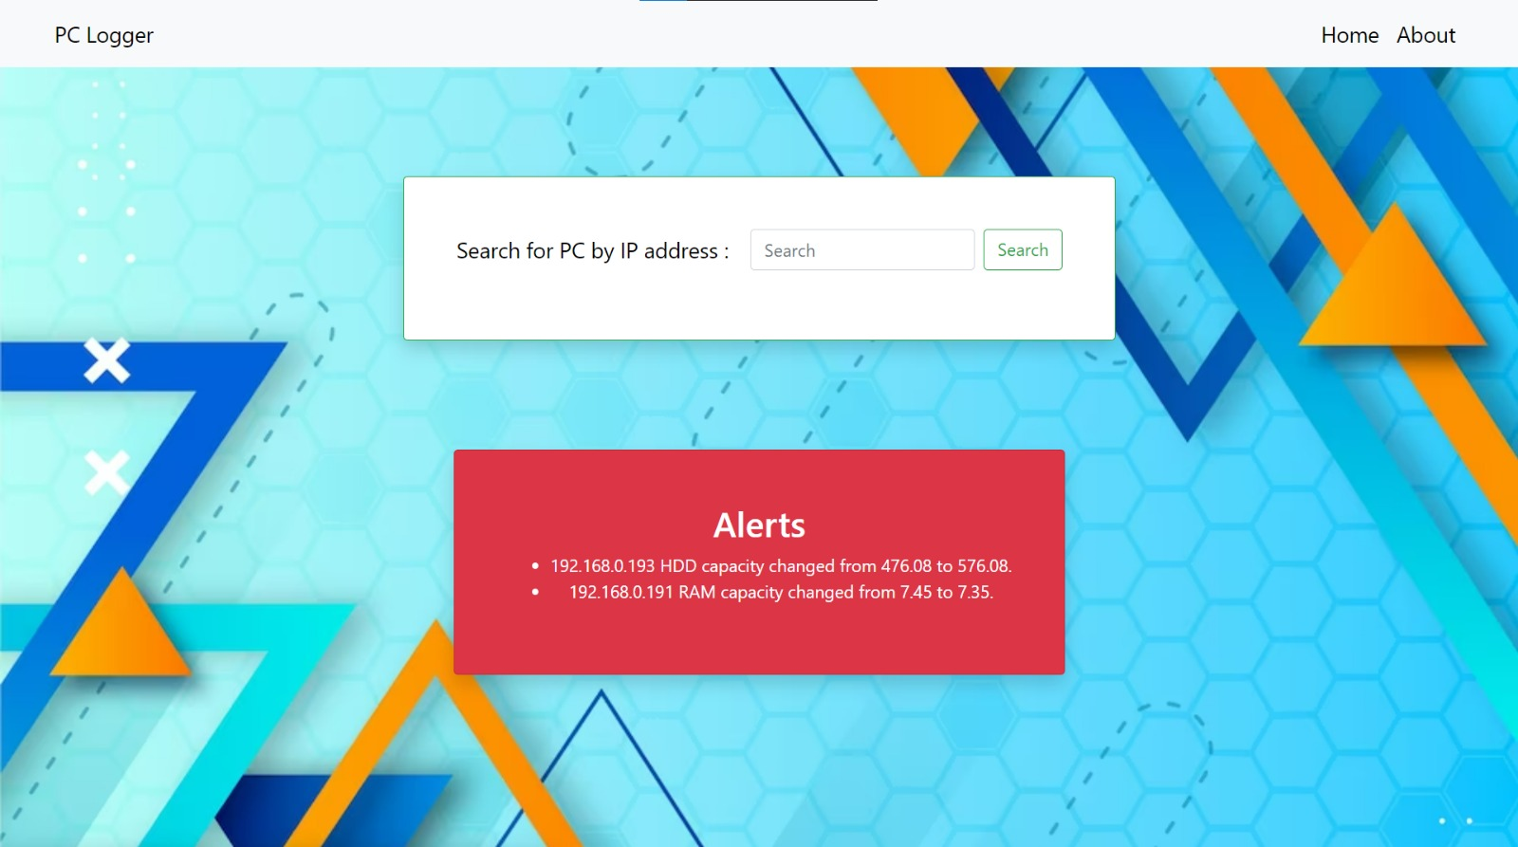
Output

Slide 12
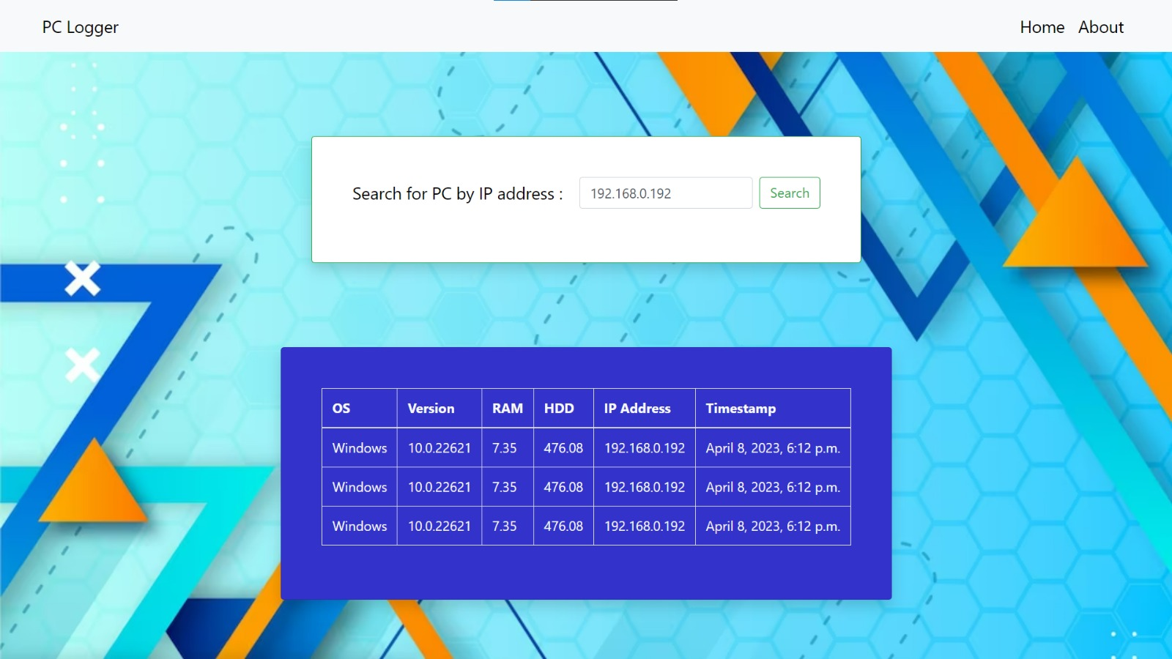
Output

Slide 13
Conclusion
The PC Logger project is a powerful tool for system monitoring and reporting, providing users with valuable insights into their PC performance and critical alerts.
The project has been successfully implemented using Python and Django, and its architecture allows for easy scalability and customization.
Overall, the PC Logger project serves as a strong foundation for the development of a robust system monitoring and reporting tool that could be used in a variety of industries and applications.

Slide 14
Thank You !

